Slide 1
Build iOS native apps with the Microsoft Graph REST API
Integrate the Microsoft Graph into an app

Slide 2

Building Microsoft Graph applications
Microsoft Graph iOS SDK
GraphServiceClient
Making Requests
Microsoft Graph REST API SDK

Slide 3
Microsoft Graph iOS SDK
Microsoft Graph REST API always available to all application types
Microsoft Graph iOS SDK abstracts the specifics of calling the REST API
https://github.com/microsoftgraph/msgraph-sdk-ios
Handles updating HTTP request headers and other details required by the REST API
Use ADAL iOS SDK for the Azure AD v1 endpoint
Use NXOAuth2 for the Azure AD v2 endpoint
https://github.com/microsoftgraph/msgraph-sdk-ios-nxoauth2-adapter
Notes:
Developers can leverage the Microsoft Graph REST API in any type of application
Microsoft also provides a native iOS SDK for the Microsoft Graph
Abstracts the details of working with a REST API
SDK provides a fluent API for creating requests
MSAL iOS SDK is not compatible with the iOS SDK

Slide 4
Integrating Microsoft Graph for iOS apps

Slide 5
Add Microsoft Graph’s iOS SDK to the App
Microsoft Graph provides an iOS implementation of the SDK
Similar to the other libraries, use CocoaPods to add the Microsoft Graph iOS SDK to the project
pod 'MSGraphSDK', '~> 0.10
Notes:
Just like the Azure AD MSAL iOS SDK…
The Microsoft Graph team provides an iOS SDK for native iOS applications
Add this to your project using podfile
pod 'MSGraphSDK', '~> 0.10
CocoaPods is a build & package management tool commonly used in iOS development
Similar to MSBuild + NuGet in a .NET project

Slide 6
Microsoft Graph REST API in iOS Apps
Microsoft Graph iOS SDK is not compatible with the MSAL iOS SDK
In order to use the Azure AD OAuth2 v2 endpoint:
Use NXOAuth2 + Microsoft Graph iOS SDK
Use MSAL iOS + Microsoft Graph REST API

Slide 7
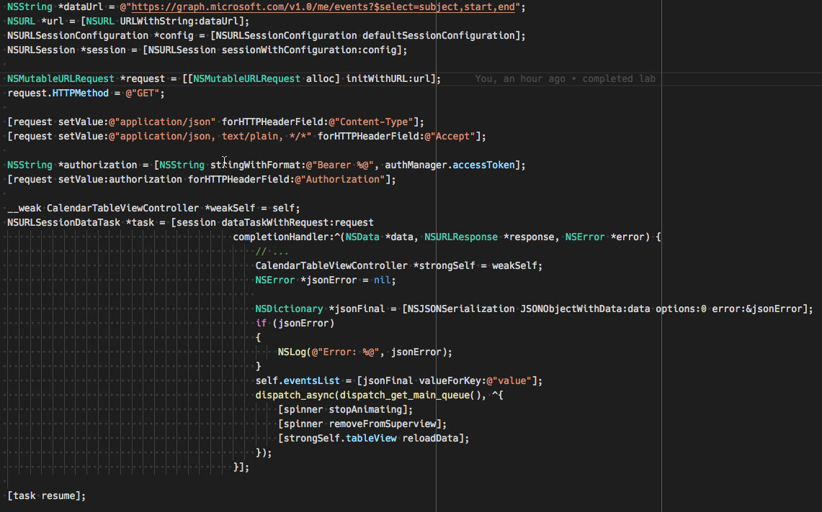
Calling the Microsoft Graph REST API from Objective-C

Slide 8
Demo

Slide 9
Thank you.

